Slide 1

Metal 3D Printer
Nathan Krikawa, Nolan Hann

Slide 2

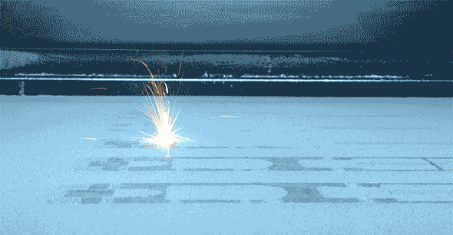
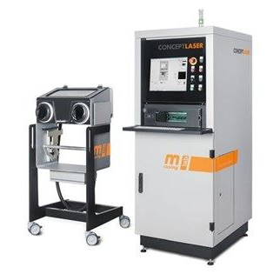
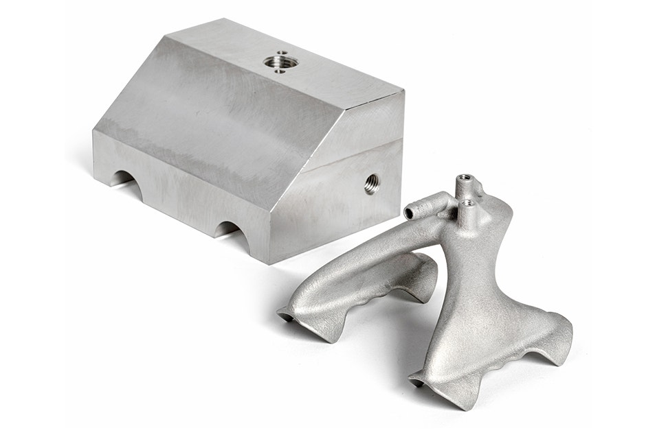
Project Description
Overview:
Commissioning of Concept Laser Mlab Cusing R metal 3D printer
Donated by Honeywell to NAU’s ME department for the IDEA Lab
Our Job:
Install and restore printer to proper functionality.
Evaluate printed specimen against machined counterparts
Print final part as part of assembly using topology optimization
Create instruction manual for training purposes in preparation for work orders and ME286L curriculum expansion
Figure 2: Selective laser melting
Figure 1: Concept Laser Mlab Cusing R
Figure 3: Redesigned aluminum gripper
Notes:
Overview:
Installing and Troubleshooting a M100LabR Concept Laser PBF Printer
Printing and evaluating parts and specimens (ie Stress-Strain, Thermal Management)
Creation of a user manual and short curriculum for ME286L
Included is the printer itself, powder mixer, powder trolley, and various powdered alloys for use with the printer
Location of set-up: CEIAS IDEA Lab, Room 116A

Slide 3
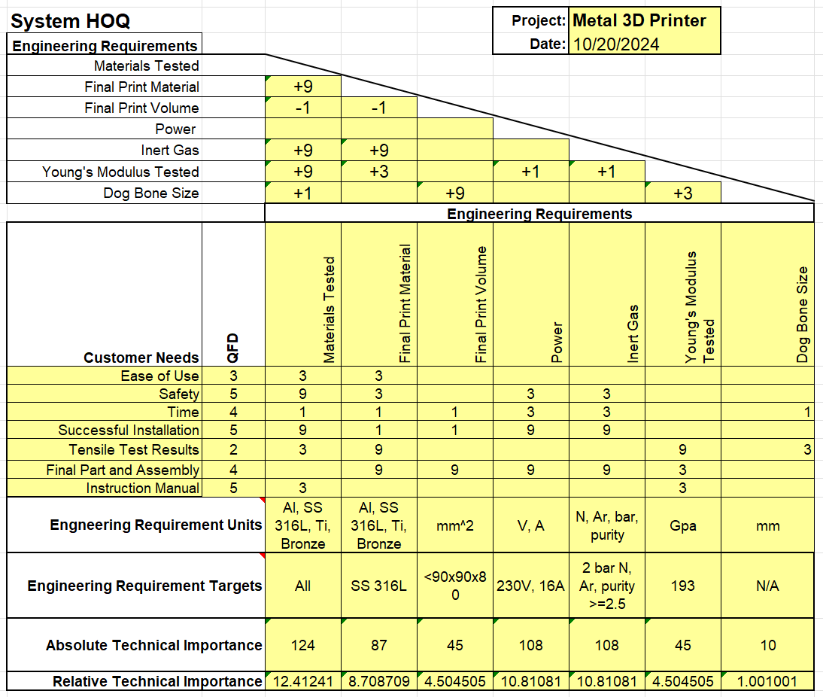
Design Requirements
Engineering Requirements
Materials Tested
Final Print Material
Final Print Volume
Power
Inert Gas
Young’s Modulus Tested
Dog Bone Size
Customer Requirements
Ease of Use
Safety
Time
Successful Installation
Tensile Test Results
Final Part and Assembly
Instruction Manual
Notes:
Overview:
Installing and Troubleshooting a M100LabR Concept Laser PBF Printer
Printing and evaluating parts and specimens (ie Stress-Strain, Thermal Management)
Creation of a user manual and short curriculum for ME286L
Included is the printer itself, powder mixer, powder trolley, and various powdered alloys for use with the printer
Location of set-up: CEIAS IDEA Lab, Room 116A

Slide 4
Design Requirements Cont.
CR Relations
High correlation:
  Time
  Safety
  Successful Installation
  Final Part and Assembly
ER Relations
High correlation:
  Materials Tested
  Final Print Material
  Power
  Inert Gas
  Final Print Volume
Notes:
Overview:
Installing and Troubleshooting a M100LabR Concept Laser PBF Printer
Printing and evaluating parts and specimens (ie Stress-Strain, Thermal Management)
Creation of a user manual and short curriculum for ME286L
Included is the printer itself, powder mixer, powder trolley, and various powdered alloys for use with the printer
Location of set-up: CEIAS IDEA Lab, Room 116A

Slide 5
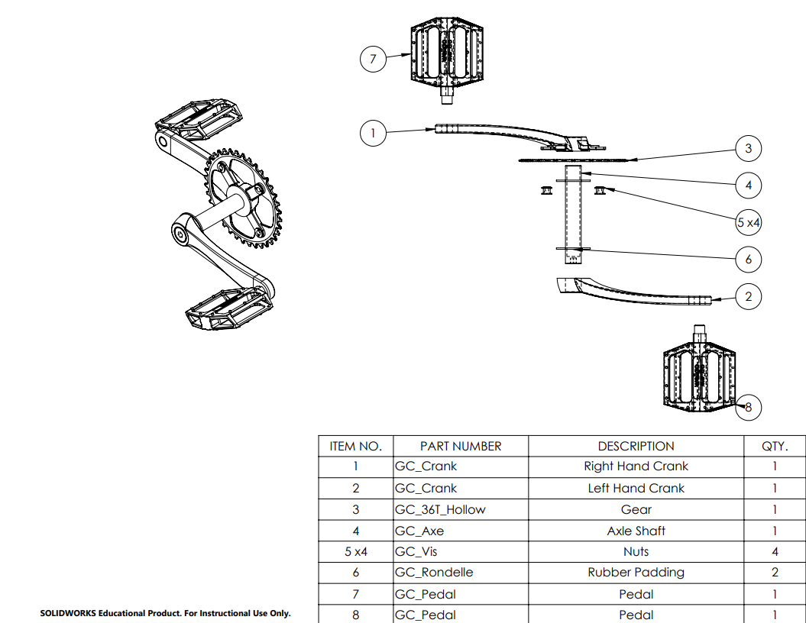
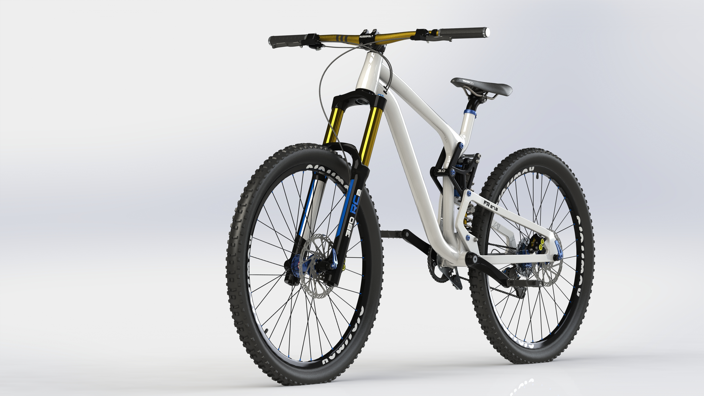
Design Description - Nolan
Bicycle Crankarm Function
Transfers human motion into mechanical energy that creates rotation in bike wheels
Figure 5: Pedal Assembly
Figure 4: Mountain Bike
Notes:
Overview:
Installing and Troubleshooting a M100LabR Concept Laser PBF Printer
Printing and evaluating parts and specimens (ie Stress-Strain, Thermal Management)
Creation of a user manual and short curriculum for ME286L
Included is the printer itself, powder mixer, powder trolley, and various powdered alloys for use with the printer
Location of set-up: CEIAS IDEA Lab, Room 116A

Slide 6
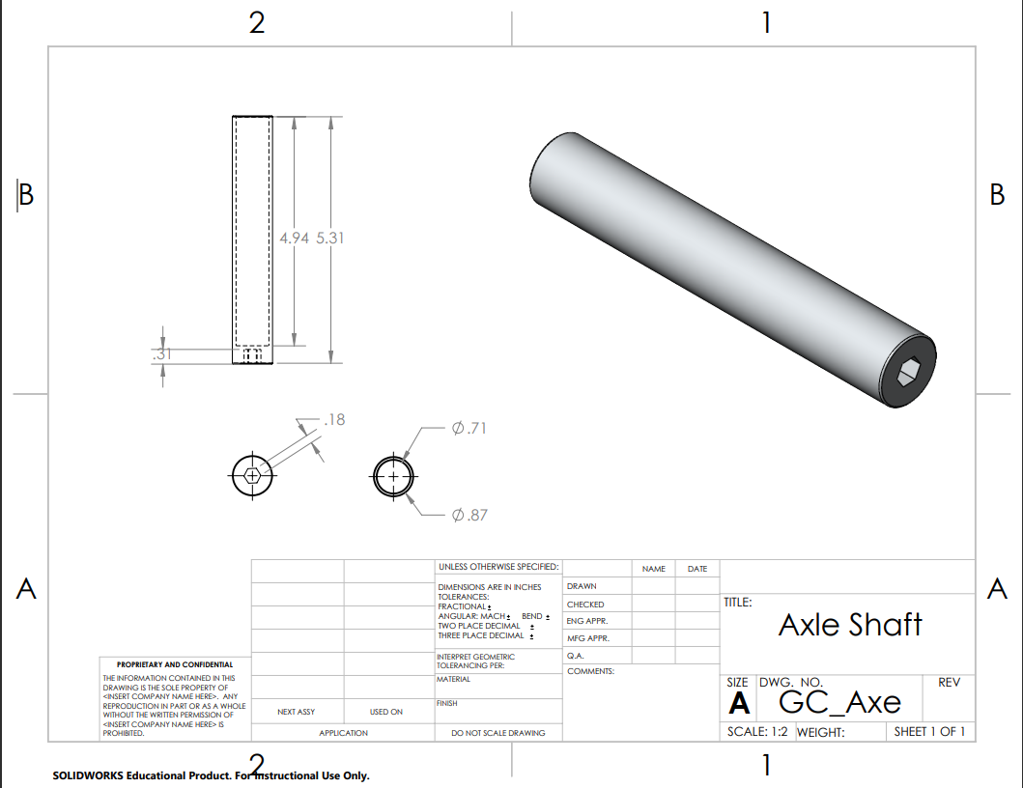
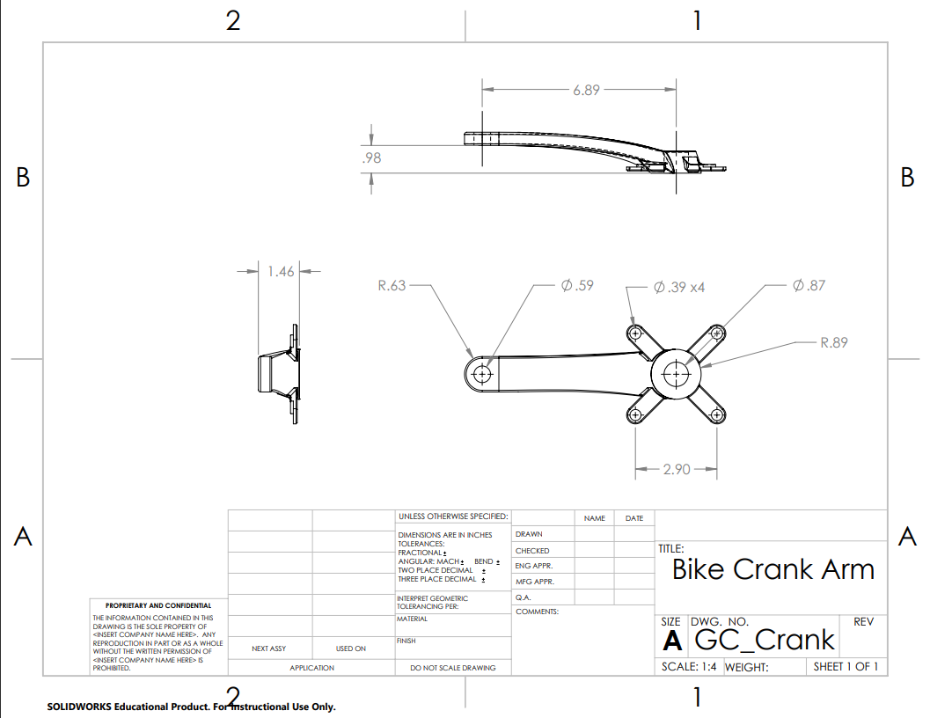
Design Description - Nolan
Figure 6: Axle Shaft Drawing
Figure 7: Crank Arm Drawing
Notes:
Overview:
Installing and Troubleshooting a M100LabR Concept Laser PBF Printer
Printing and evaluating parts and specimens (ie Stress-Strain, Thermal Management)
Creation of a user manual and short curriculum for ME286L
Included is the printer itself, powder mixer, powder trolley, and various powdered alloys for use with the printer
Location of set-up: CEIAS IDEA Lab, Room 116A

Slide 7
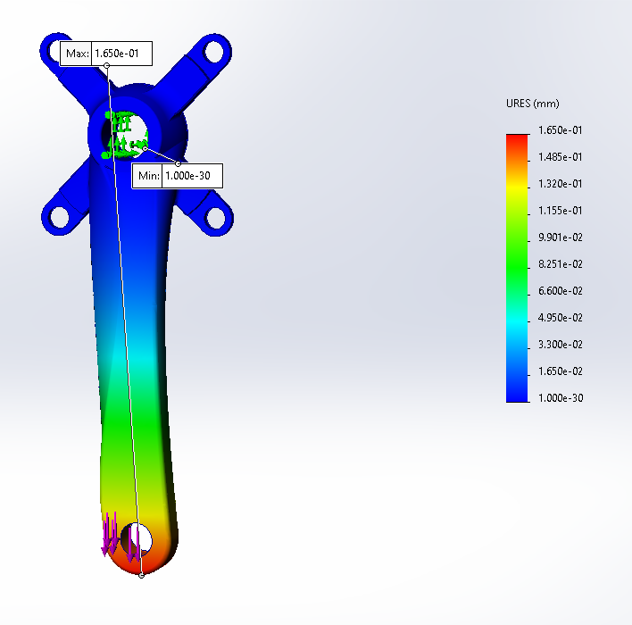
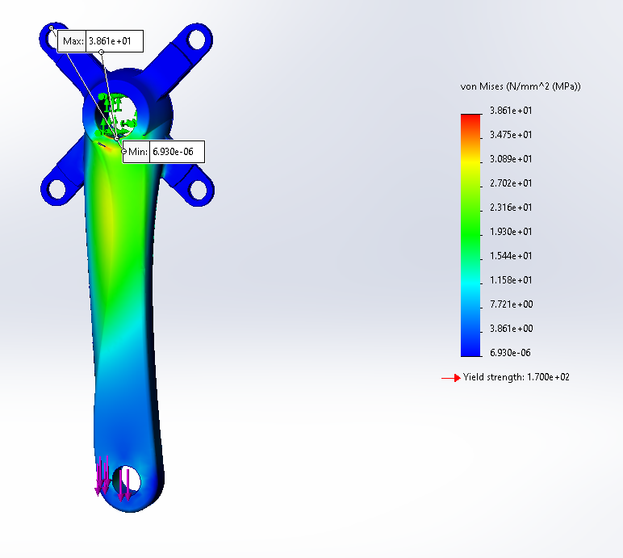
Engineering Calcs. - Nolan
FEA
  Used a Force of 1815 N, the average force applied by a human to a bike
  Used central shaft as fixture, applied force at the bottom of the crank arm, where the pedal is at the lowest
  Results:
  Max Stress: 38.6 MPa
  Max Displacement: 0.165 mm
[1] P. D. Soden and B. A. Adeyefa, “Forces applied to a bicycle during normal cycling,” Journal of Biomechanics, vol. 12, no. 7, pp. 527–541, Jan. 1979, doi: https://doi.org/10.1016/0021-9290(79)90041-1.
Figure 8: Crank Arm FEA: Displacement
Figure 9: Crank Arm FEA: Stress
Notes:
Overview:
Installing and Troubleshooting a M100LabR Concept Laser PBF Printer
Printing and evaluating parts and specimens (ie Stress-Strain, Thermal Management)
Creation of a user manual and short curriculum for ME286L
Included is the printer itself, powder mixer, powder trolley, and various powdered alloys for use with the printer
Location of set-up: CEIAS IDEA Lab, Room 116A

Slide 8
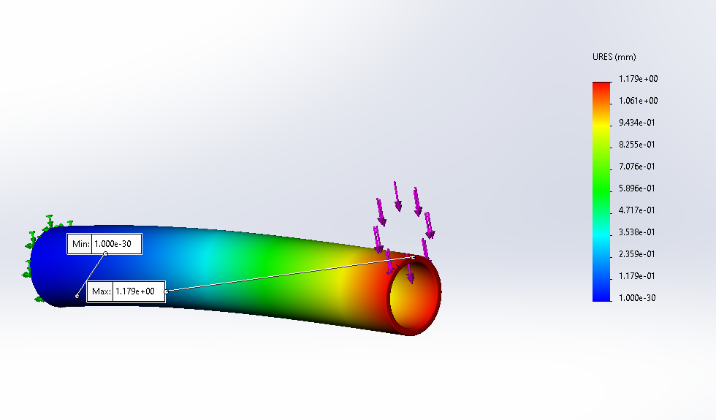
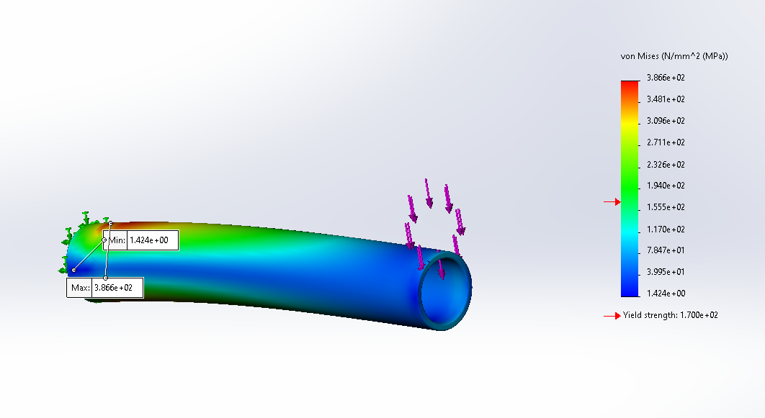
Engineering Calcs. - Nolan
FEA
  Same force applied, set the left side of the shaft as a fixture
  Deflection is smaller due to actual fixture.
  Results:
  Max Stress: 386 MPa
  Max Deformation: 1.17 mm
Figure 11: Shaft FEA: Displacement​
Figure 10: Shaft FEA: Stress​
Notes:
Overview:
Installing and Troubleshooting a M100LabR Concept Laser PBF Printer
Printing and evaluating parts and specimens (ie Stress-Strain, Thermal Management)
Creation of a user manual and short curriculum for ME286L
Included is the printer itself, powder mixer, powder trolley, and various powdered alloys for use with the printer
Location of set-up: CEIAS IDEA Lab, Room 116A

Slide 9
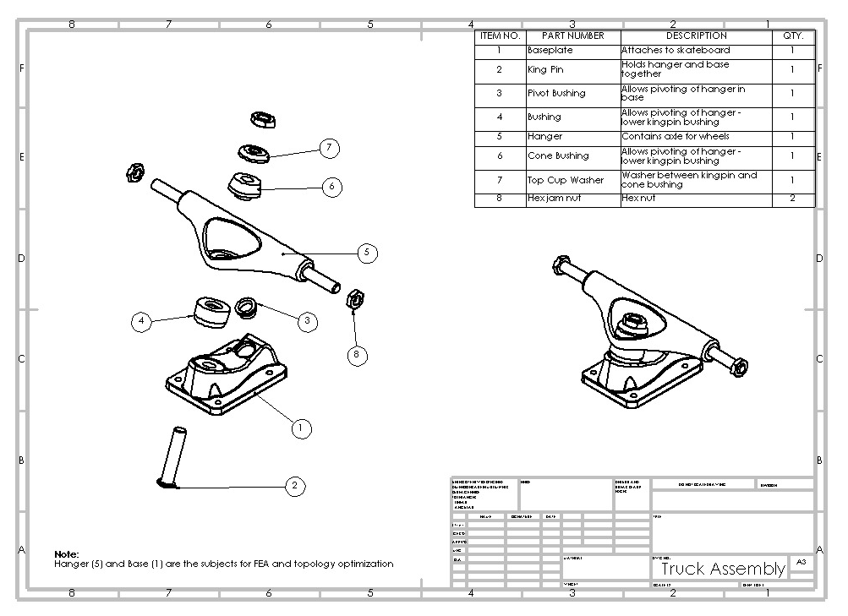
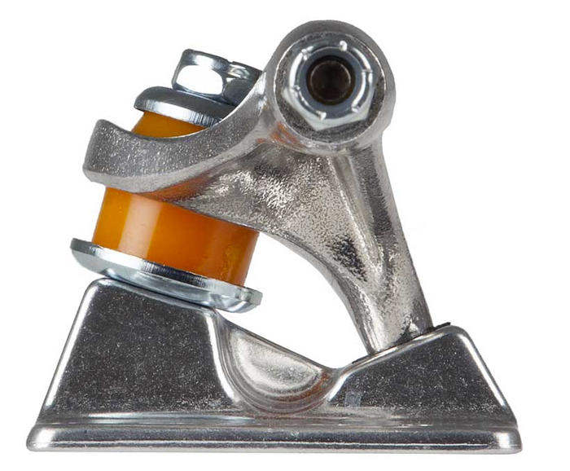
Design Description - Nathan
Function:
Hanger pivots from side to side
  Kingpin bushings and pivot socket
Allows for controlled turning by putting pressure on those bushings
Pivot axis is tilted to allow for both horizontal and vertical rotation
Pivot Axis
Figure 13: Truck Assembly Drawing
Figure 12: Truck pivot axis
Notes:
Overview:
Installing and Troubleshooting a M100LabR Concept Laser PBF Printer
Printing and evaluating parts and specimens (ie Stress-Strain, Thermal Management)
Creation of a user manual and short curriculum for ME286L
Included is the printer itself, powder mixer, powder trolley, and various powdered alloys for use with the printer
Location of set-up: CEIAS IDEA Lab, Room 116A

Slide 10
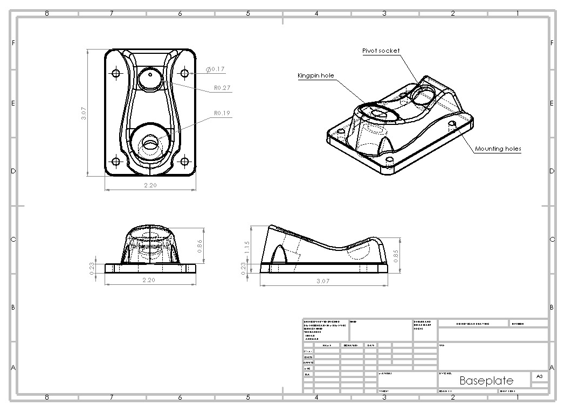
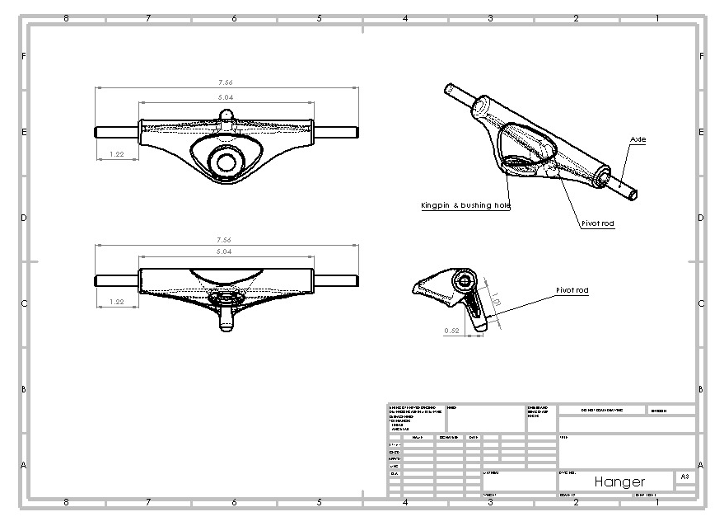
Design Description - Nathan
Figure 14: Baseplate Drawing
Figure 15: Hanger Drawing
Notes:
Overview:
Installing and Troubleshooting a M100LabR Concept Laser PBF Printer
Printing and evaluating parts and specimens (ie Stress-Strain, Thermal Management)
Creation of a user manual and short curriculum for ME286L
Included is the printer itself, powder mixer, powder trolley, and various powdered alloys for use with the printer
Location of set-up: CEIAS IDEA Lab, Room 116A

Slide 11
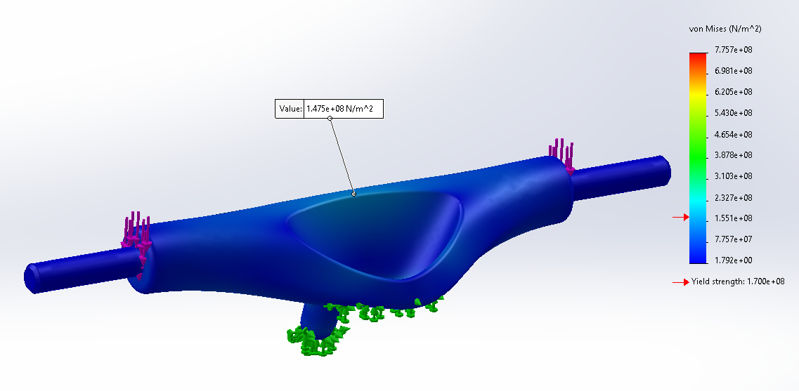
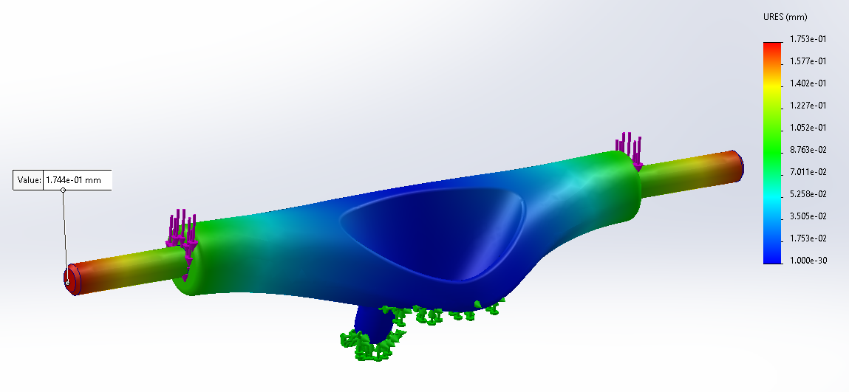
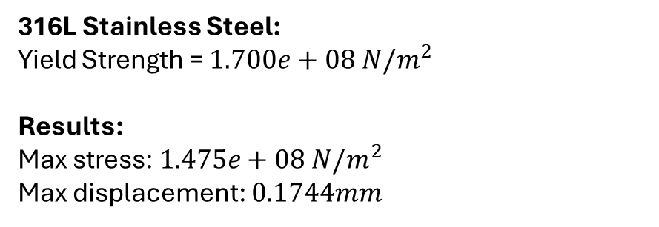
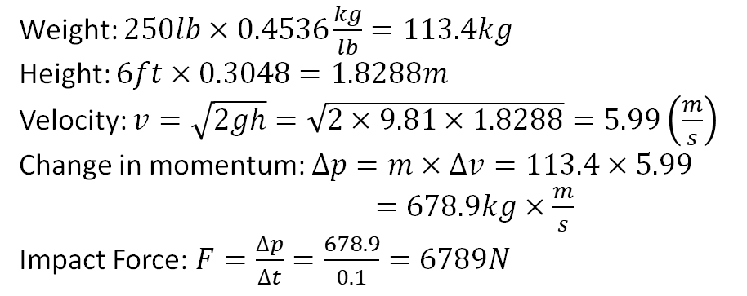
Eng. Calculations - Nathan
Load Case: 250lb person falling 6ft onto one truck
Weight: $250lb×0.4536\frac{kg}{lb}=113.4kg$
Height: $6ft×0.3048=1.8288m$
Velocity: $v=\sqrt{2gh}=\sqrt{2×9.81×1.8288}=5.99\left(\frac{m}{s}\right)$
Change in momentum: $∆p=m×∆v=113.4×5.99$
$=678.9kg×\frac{m}{s}$
Impact Force: $F=\frac{∆p}{∆t}=\frac{678.9}{0.1}=6789N$
Figure 16: Truck Hangar FEA: Stress
316L Stainless Steel:
Yield Strength = $1.700e+08 N/m^{2}$
Results:
Max stress: $1.475e+08 N/m^{2}$
Max displacement: $0.1744mm$
Figure 17: Truck Hangar FEA: Displacement
Notes:
Overview:
Installing and Troubleshooting a M100LabR Concept Laser PBF Printer
Printing and evaluating parts and specimens (ie Stress-Strain, Thermal Management)
Creation of a user manual and short curriculum for ME286L
Included is the printer itself, powder mixer, powder trolley, and various powdered alloys for use with the printer
Location of set-up: CEIAS IDEA Lab, Room 116A

Slide 12
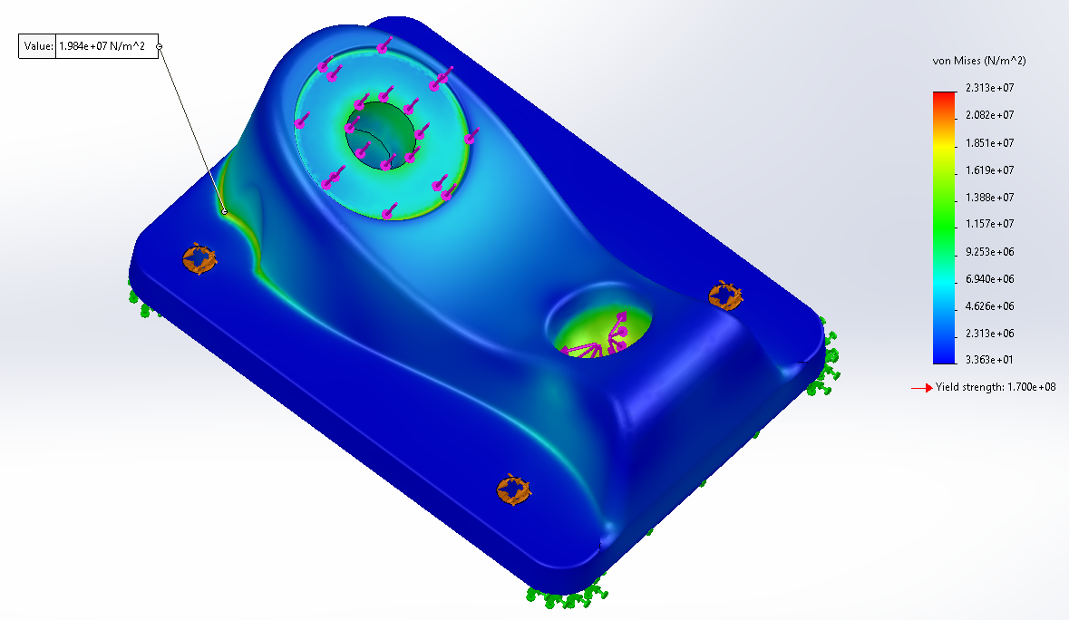
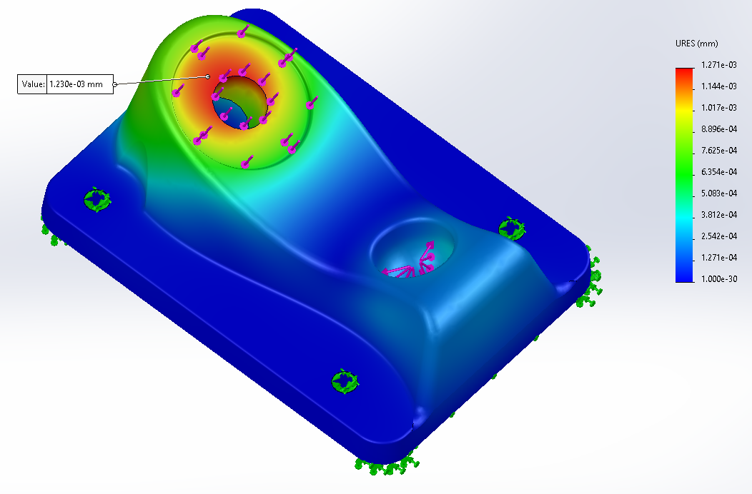
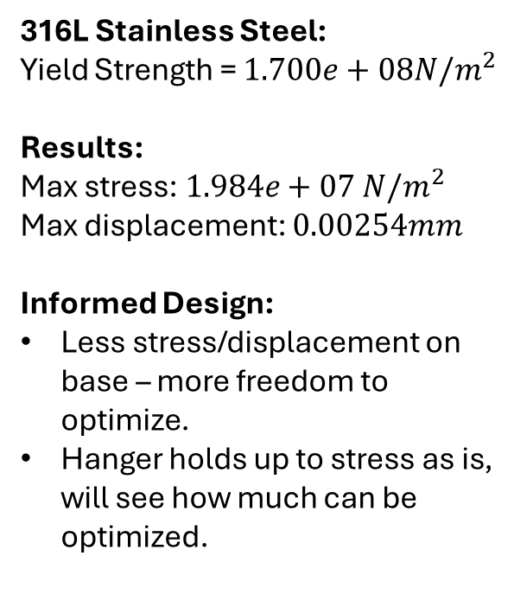
Eng. Calculations - Nathan
Load Case: 250lb person falling 6ft onto one truck
316L Stainless Steel:
Yield Strength = $1.700e+08N/m^{2}$
Results:
Max stress: $1.984e+07 N/m^{2}$
Max displacement: $0.00254mm$
Informed Design:
Less stress/displacement on base – more freedom to optimize.
Hanger holds up to stress as is, will see how much can be optimized.
Figure 18: Truck Base FEA: Stress
Figure 19: Truck Base FEA: Displacement
Notes:
Overview:
Installing and Troubleshooting a M100LabR Concept Laser PBF Printer
Printing and evaluating parts and specimens (ie Stress-Strain, Thermal Management)
Creation of a user manual and short curriculum for ME286L
Included is the printer itself, powder mixer, powder trolley, and various powdered alloys for use with the printer
Location of set-up: CEIAS IDEA Lab, Room 116A

Slide 13
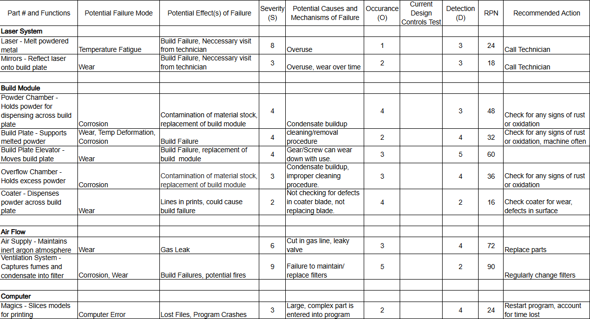
FMEA - Printer
Critical potential failures/ how to mitigate
Build Plate
Build Plate Elevator
Coater
Ventilation System
Testing Procedures
Regular maintenance
Inspect module for damage or corrosion
Testing Resources
User manual
Excel Charts
Calendar
Figure 20: Printer FMEA
Notes:
Overview:
Installing and Troubleshooting a M100LabR Concept Laser PBF Printer
Printing and evaluating parts and specimens (ie Stress-Strain, Thermal Management)
Creation of a user manual and short curriculum for ME286L
Included is the printer itself, powder mixer, powder trolley, and various powdered alloys for use with the printer
Location of set-up: CEIAS IDEA Lab, Room 116A

Slide 14
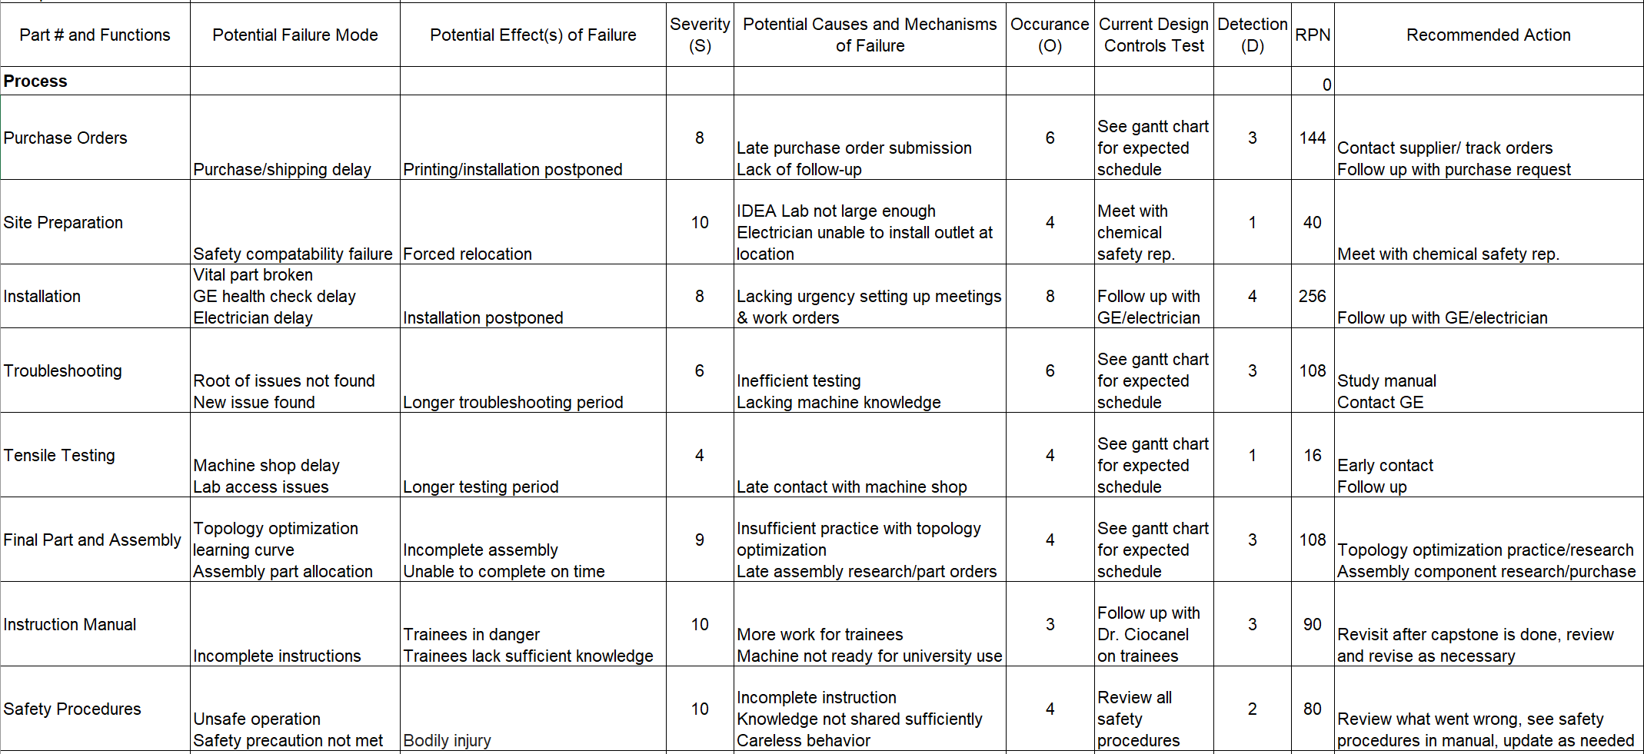
FMEA - Process
Critical Potential Failures
Purchase orders
Installation
Troubleshooting
Final part and assembly
Testing procedures
Stay in contact with outside resources
Stay ahead of learning curve
Frequently update and review Gantt chart
Testing Resources
Gmail
Excel
SolidWorks
Udemy
Figure 21: Process FMEA
Notes:
Overview:
Installing and Troubleshooting a M100LabR Concept Laser PBF Printer
Printing and evaluating parts and specimens (ie Stress-Strain, Thermal Management)
Creation of a user manual and short curriculum for ME286L
Included is the printer itself, powder mixer, powder trolley, and various powdered alloys for use with the printer
Location of set-up: CEIAS IDEA Lab, Room 116A

Slide 15
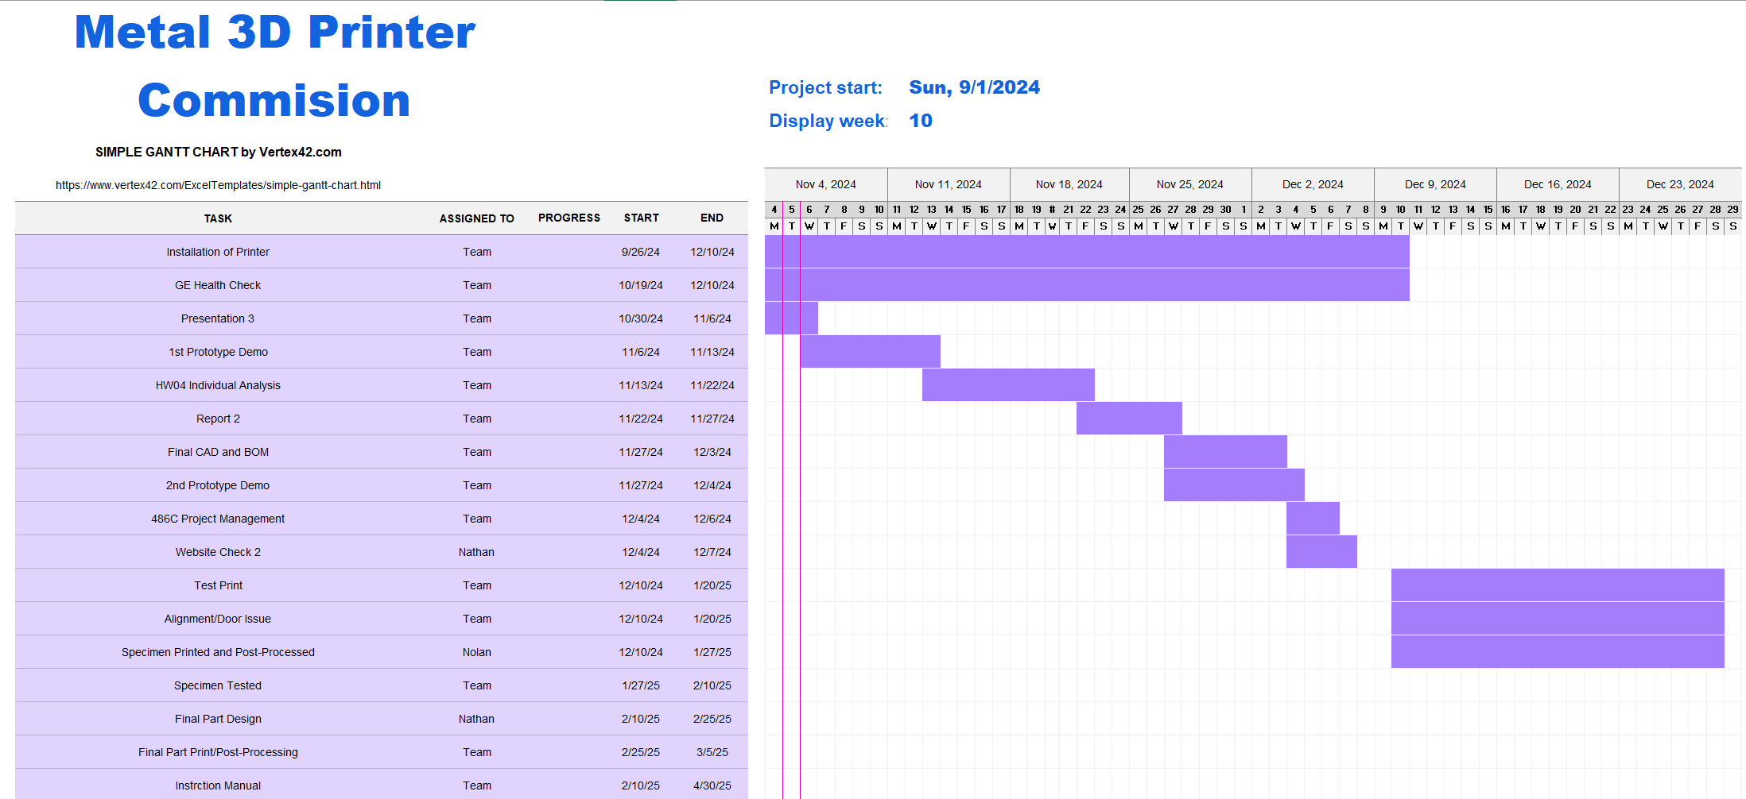
Schedule

Slide 16
Budget
Item | Quantity | Price ($)
N95 Masks | 2 | 44
Wet Separating Vacuum | 1 | 9850
Static Strap | 1 | 13
Gas Tank Holder | 1 | 24
Gloves | 1 | 8.70
Safety Glasses | 2 | 24.40
Total: |  | 9964.10

Slide 17

Thank You!
Any Questions?

